Slide 1

Students Test or t-test
Presented by:
Elizer Ponio Jr.
Department of Computer Science
College of Computing and Information Technologies

Slide 2
Outline
What is a t-test?
Types of t-test
Examples of t-test

Slide 3
t-test
The t-test tells you how significant the differences between group means are.
It lets you know if those differences in means could have happened by chance.
The t-test is usually used when data sets follow a normal distribution but you don’t know the population variance.

Slide 4
t-score
The t-score is a ratio between the difference between two groups and the difference within the groups.
Larger t-scores = more difference between groups.
Smaller t-scores = more similarity between groups.

Slide 5
t-scores and p-values
Every t-score has a p-value to go with it.
A p-value from a t-test is the probability that the results from your sample data occurred by chance.
Low p-values indicate your data did not occur by chance.
For example, a p-value of .01 means that there is only a 1% probability that the results from an experiment happened by chance.

Slide 6

What is a t-test?
Types of t-test
Examples of t-test

Slide 7
Types of t-test
An independent samples t-test
A paired sample t-test
A one sample t-test

Slide 8
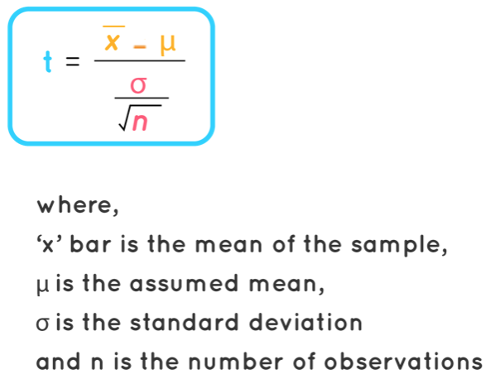
Types of t-test
An independent samples t-test compares the means for two groups.

Slide 9
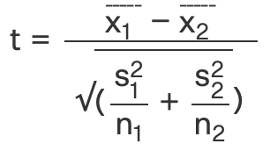
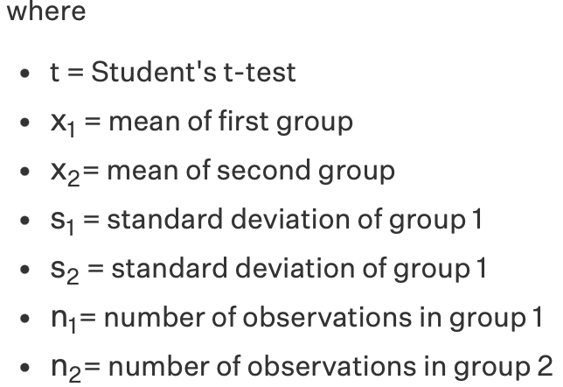
Types of t-test
A paired sample t-test compares means from the same group at different times (say, one year apart).

Slide 10
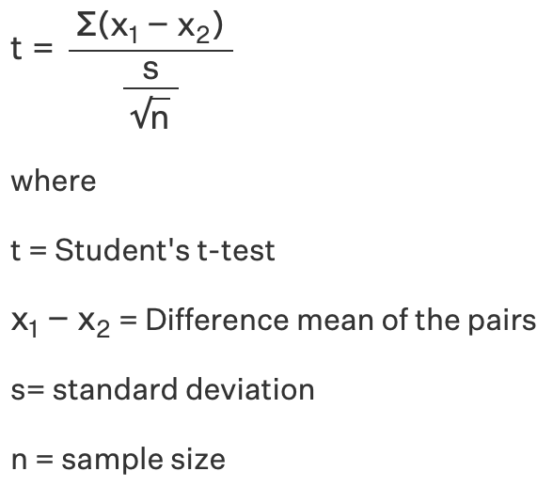
Types of t-test
A one sample t-test tests the mean of a single group against a known mean.

Slide 11
What is a t-test?
Types of t-test
Examples of t-test

Slide 12
Paired sample t-test example
Calculate a t-test for the following data of the number of times people prefer coffee or tea in five time intervals.
Coffee | Tea
4 | 3
5 | 8
7 | 6
6 | 4
9 | 7

Slide 13
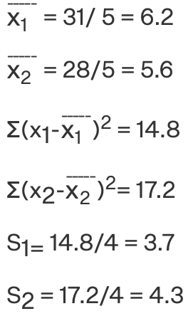
Paired sample t-test example
Calculate a t-test for the following data of the number of times people prefer coffee or tea in five time intervals.

Slide 14
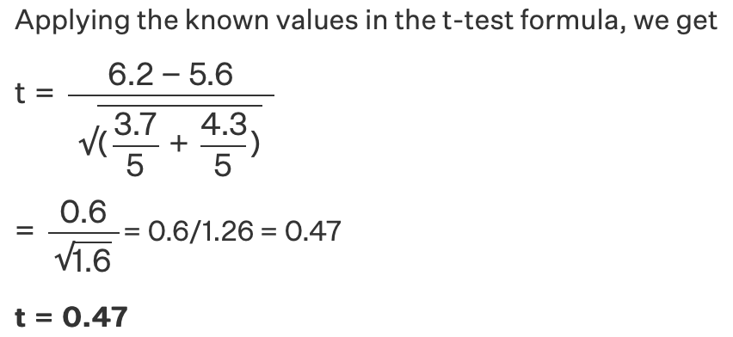
Paired sample t-test example
Calculate a t-test for the following data of the number of times people prefer coffee or tea in five time intervals.

Slide 15
Independent sample t-test example
A company wants to improve its sales. The previous sales data indicated that the average sale of 25 salesmen was $50 per transaction.
After training, the recent data showed an average sale of $80 per transaction. If the standard deviation is $15, find the t-score.
Has the training provided improved the sales?

Slide 16
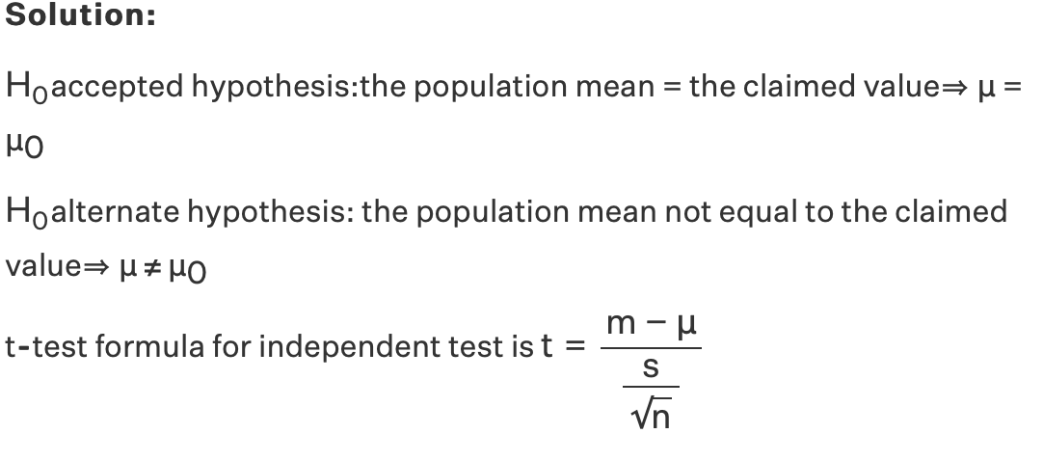
Independent sample t-test example

Slide 17
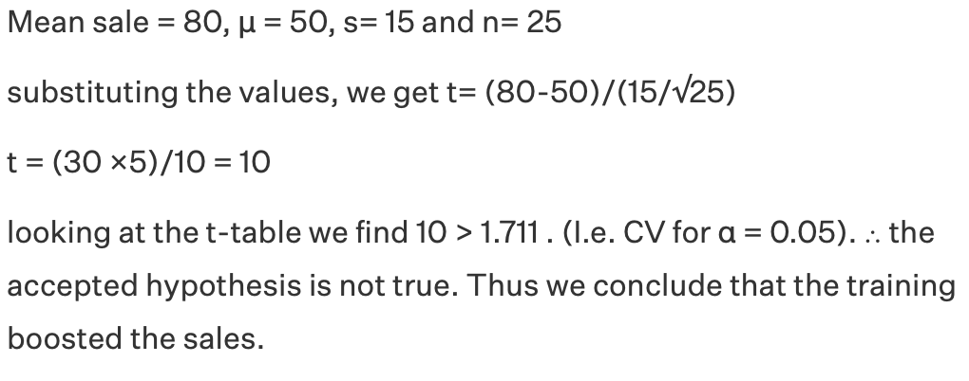
Independent sample t-test example
Degree of freedom | 0.50 | 0.25 | 0.20 | 015 | 0.10 | 0.05
24 | 0.000 | 0.685 | 0.857 | 1.059 | 1.318 | 1.711
25 | 0.000 | 0.684 | 0.856 | 1.058 | 1.316 | 1.708
26 | 0.000 | 0.684 | 0.856 | 1.058 | 1.315 | 1.706

